Slide 1
process concept
By:- Uzma Banu
Operating System

Slide 2
Introduction
An execution of program is called process. It is an active entity. It contain program code as well as current information for execution the program. Like it has program counter which store address of the next instruction and it has stack, CPU register, data section etc.

Slide 3
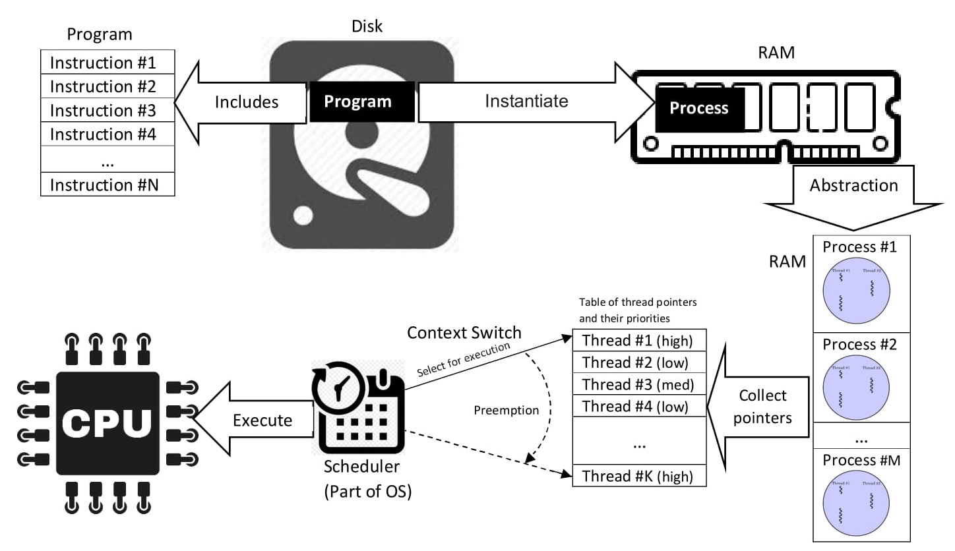
Fig:- Process in OS

Slide 4
Process Components
Text Section: This contains the executable code of the program.
Data Section: This includes global and static variables used by the program.
Stack: It is used for the function call and local variables.
Heap: Dynamically allocated memory during runtime.

Slide 5
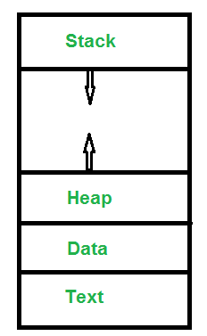
Fig:- Process Components

Slide 6
Process Control Block (PCB)
Each process is represented by a data structure known as the Process Control Block (PCB). The PCB contains information about the process, including its process ID, state, program counter, registers, memory pointers, and other relevant information.

Slide 7
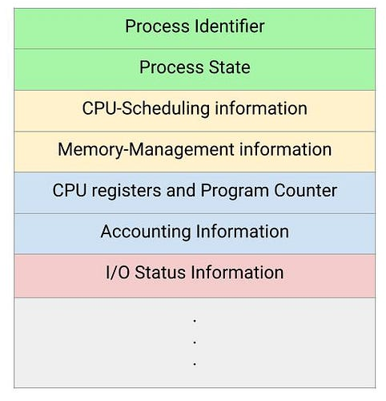
Fig:- Process Control Block (PCB)

Slide 8
Process States
A process goes through different states during its lifecycle. The common process states include :
New: The process is being created.
Ready: The process is waiting to be assigned to a processor.
Running: The instructions are being executed.
Blocked (Wait): The process is waiting for some event to occur.
Terminated: The process has finished execution.

Slide 9
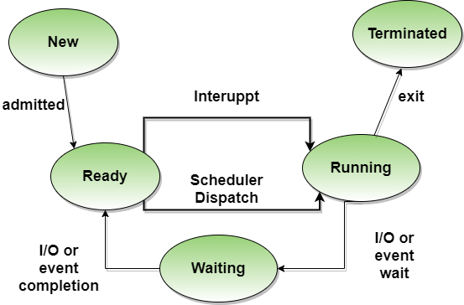
Fig:- process state

Slide 10
Thanks...!

